Slide 1
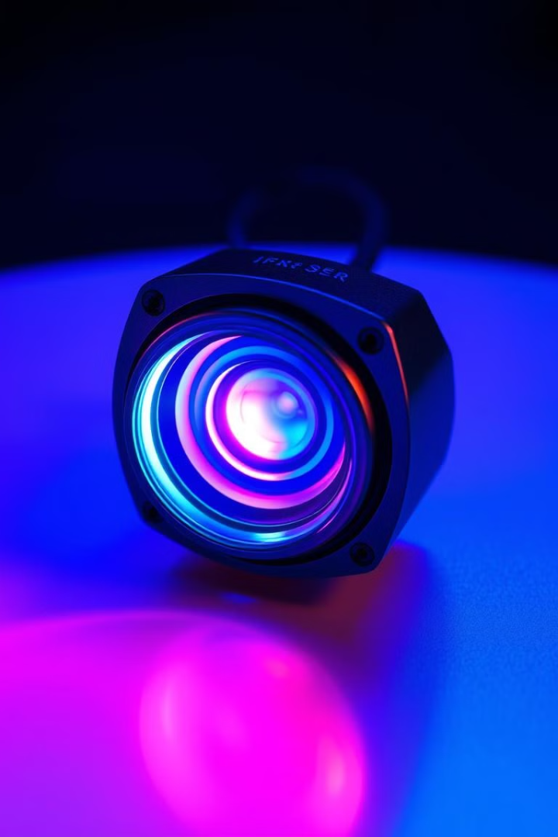

Introduction to Infrared (IR) Sensors
This presentation will explore infrared (IR) sensors: their history, principles, types, and applications. We'll delve into how they function, their advantages, limitations, and future trends.
by swaraj

Slide 2
Fundamentals of Infrared Radiation
Electromagnetic Spectrum
Types of IR Radiation
Stefan-Boltzmann Law
Wien's Displacement Law
Infrared radiation is part of the electromagnetic spectrum, spanning wavelengths from 0.7 to 1000 micrometers. It sits between visible light and microwaves.
NIR (Near-Infrared), MIR (Mid-Infrared), and FIR (Far-Infrared) are the three types of IR radiation.
This law states that an object's total energy radiated is proportional to the fourth power of its absolute temperature.
The peak wavelength of an object's emitted radiation is inversely proportional to its temperature.

Slide 3
Types of IR Sensors: Thermal vs. Quantum
Thermal IR Sensors
Quantum IR Sensors
Detect temperature changes caused by IR radiation.
Detect IR photons directly, causing a change in electrical properties.
Examples include thermopiles, bolometers, and pyroelectric sensors.
Examples include photodiodes, phototransistors, and photoconductive detectors.
They are slower and respond to a wide range of wavelengths.
These sensors are faster, more sensitive, but more wavelength-specific.

Slide 4
Working Principle: Emissive IR Sensors (IR LEDs)
Components
Operation
Signal Processing
IR LED (emitter) and a photodiode/phototransistor (detector).
The IR LED emits IR light, which is reflected back to the detector if an object is present.
A microcontroller interprets the signal, triggering an action based on the strength of the reflected signal.

Slide 5

Working Principle: Passive IR Sensors (Pyroelectric)
Components
Pyroelectric material and a Fresnel lens.
Pyroelectric Effect
Changes in temperature create a temporary voltage in the pyroelectric material.
Operation
IR radiation from a moving object causes a temperature change in the sensor, generating a voltage pulse.
Signal Processing
The voltage pulse is amplified, filtered, and used to detect the presence of motion.

Slide 6
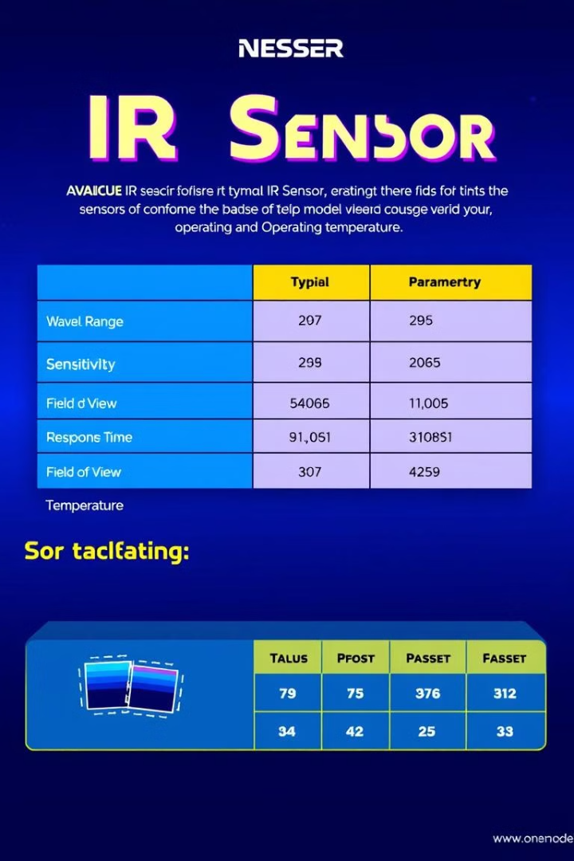




Key Specifications and Parameters
Wavelength Range
Sensitivity
Response Time
The smallest change in IR radiation the sensor can detect.
The time taken for the sensor to react to changes in IR radiation.
The range of IR wavelengths the sensor can detect (e.g., 8-14 μm for thermal imaging).
Field of View
The angular extent the sensor can "see".

Slide 7
Applications of IR Sensors
Remote Controls
1
Transmit signals to control electronics like TVs and stereos.
2
Motion Detection
Used in security systems and automatic lighting.
Thermal Imaging
3
Used in medical diagnostics, building inspection, and firefighting.
4
Gas Analysis
Monitoring atmospheric gases and industrial processes.
Non-Contact Temperature Measurement
5
Used in industrial processes and medical thermometers.

Slide 8
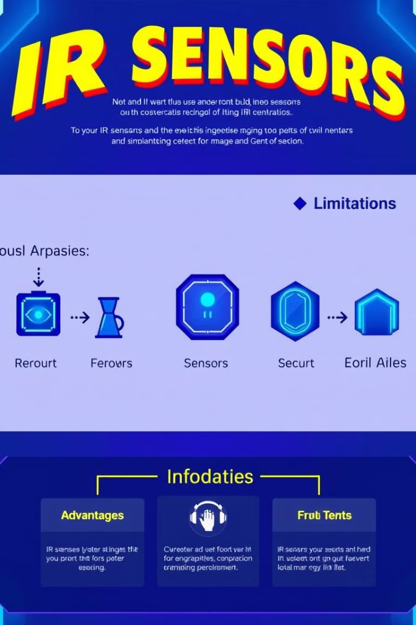



Advantages, Limitations, and Future Trends
Advantages
Non-contact measurement
Low power consumption
Relatively low cost
Limitations
Susceptible to ambient temperature changes
Limited range
Affected by obstructions
Future Trends
Miniaturization
Higher sensitivity
Smart sensors

